Slide 1
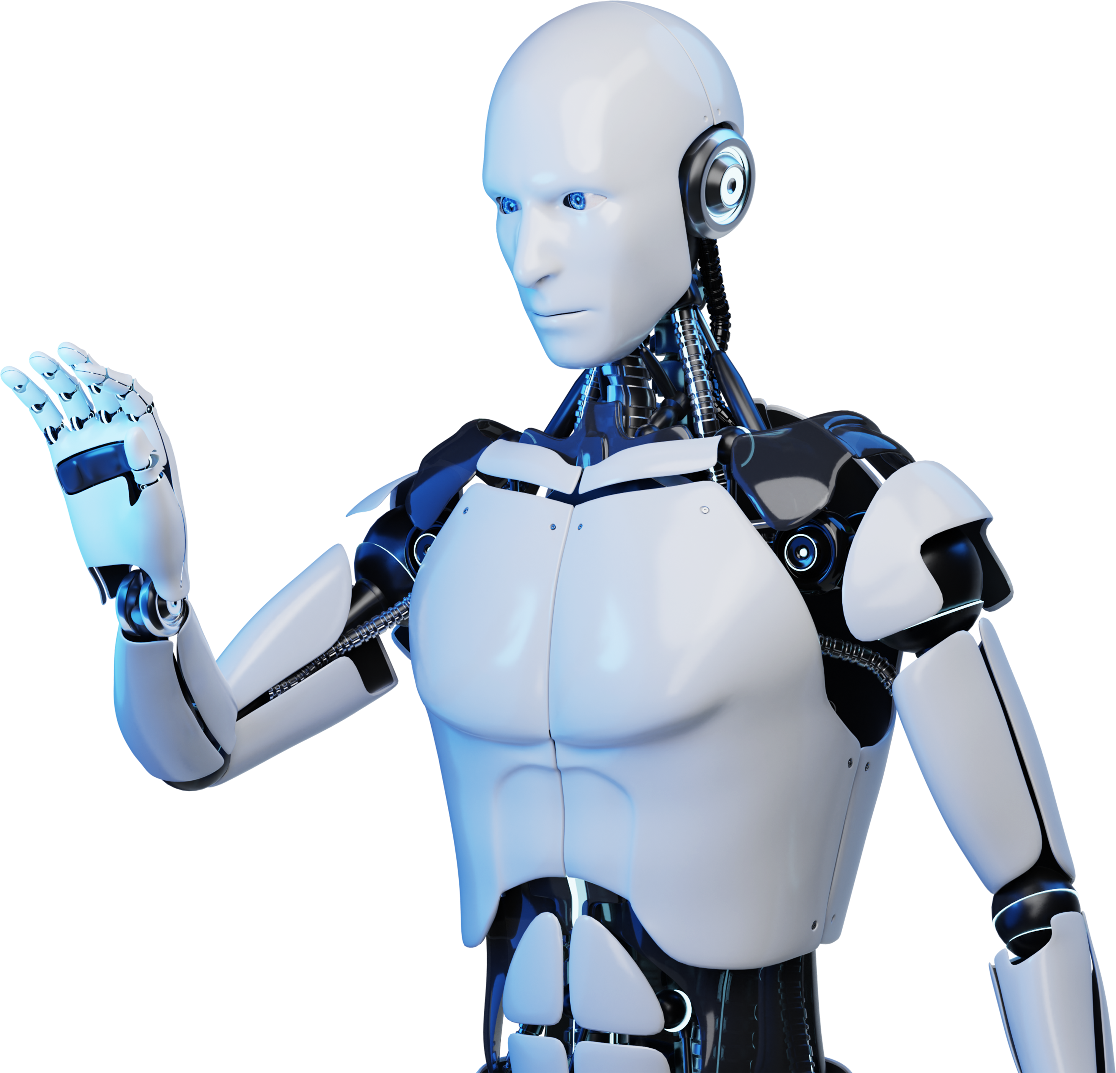
JP Morgan Chase Financial AI Agent
From wait-times to real-time – an OpenAI-powered customer experience.

Slide 2
Table Of Contents
01. Introduction of AI Chatbots
02. Design Principles
03. AI Chatbots in Education
04. Conclusion of AI Chatbots

Slide 3
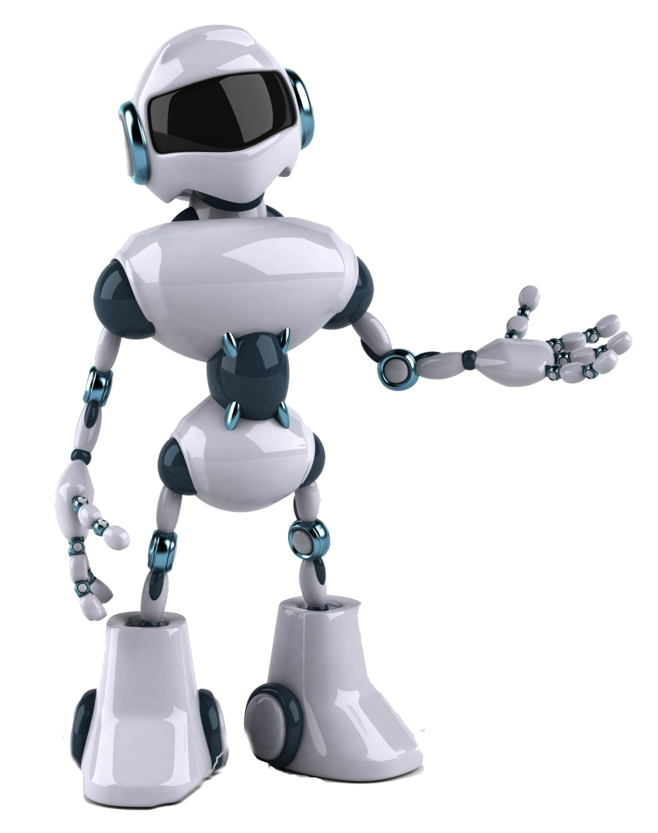
Introduction
AI-driven customer service assistant for banking.
Supports balance, transactions, savings, and document uploads.
Delivers real-time, personalized financial support using OpenAI.

Slide 4
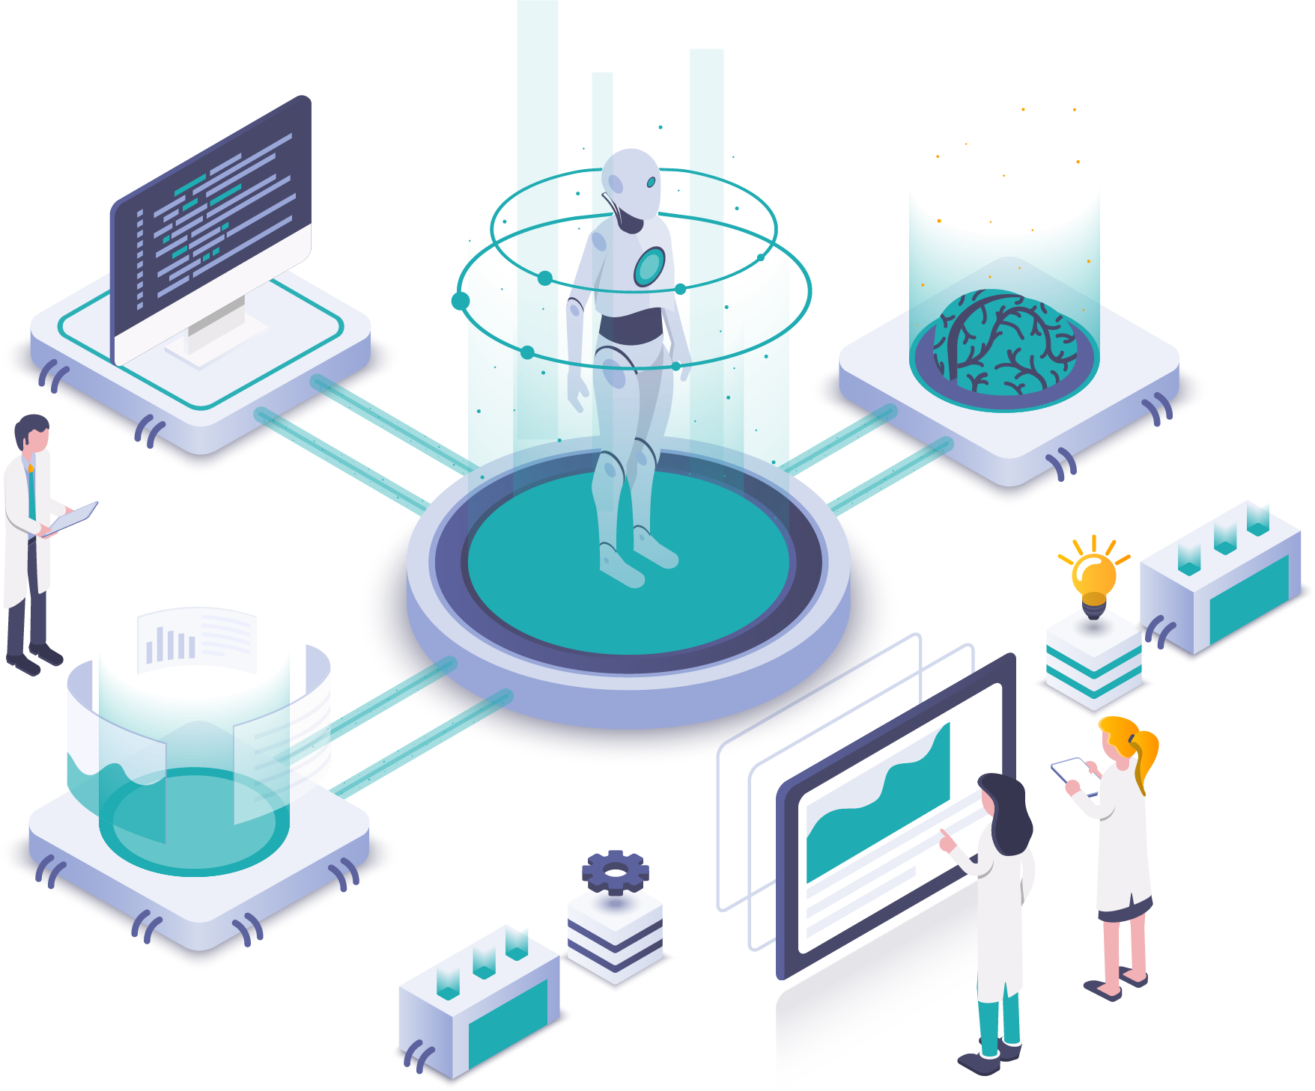
Problem Statement
Long customer wait times and limited real-time service.
Lack of personalized financial guidance.
No support for uploading and analyzing financial documents.
Poor customer experience impacting retention and costs.

Slide 5

Advantages In Customer Service
AI Chatbots in customer service offer 24/7 availability, quick response times, personalized interactions, and efficient issue resolution.

Slide 6
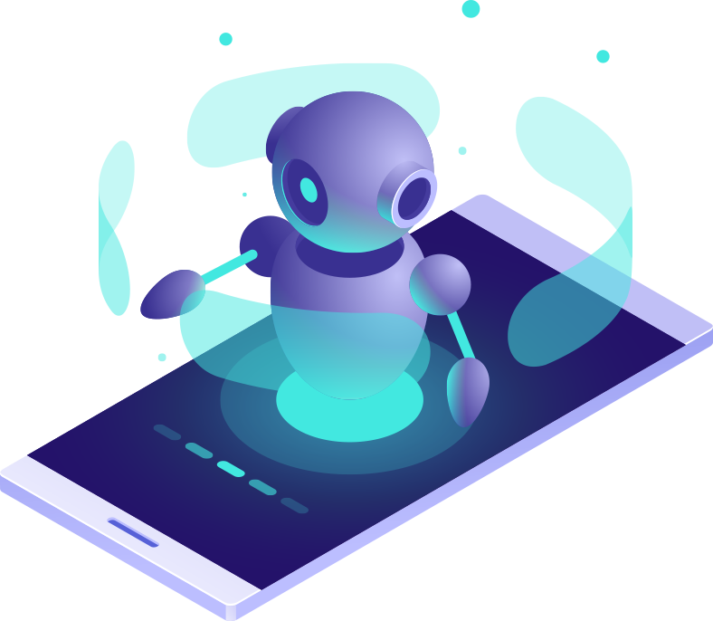
Enhancing
User Experience
By providing seamless and personalized interactions, AI Chatbots enhance user experience, making interactions more efficient and satisfying.

Slide 7
Role Of NLP
Natural Language Processing (NLP) enables AI Chatbots to understand and process human language, allowing for more effective communication.

Slide 8
Design Principles For Interactions
1
User-Centered Design
6
Accessibility and Inclusivity
2
Clarity and Simplicity
7
Learnability
3
Consistency
8
Flexibility and Control
4
Feedback and Responsiveness
9
Error Prevention and Recovery
5
Contextual Relevance
10
Delight and Emotional Engagement

Slide 9

Ethical considerations
Ethical considerations in AI Chatbots include privacy, data security, transparency, bias mitigation, and responsible deployment to ensure user trust.

Slide 10
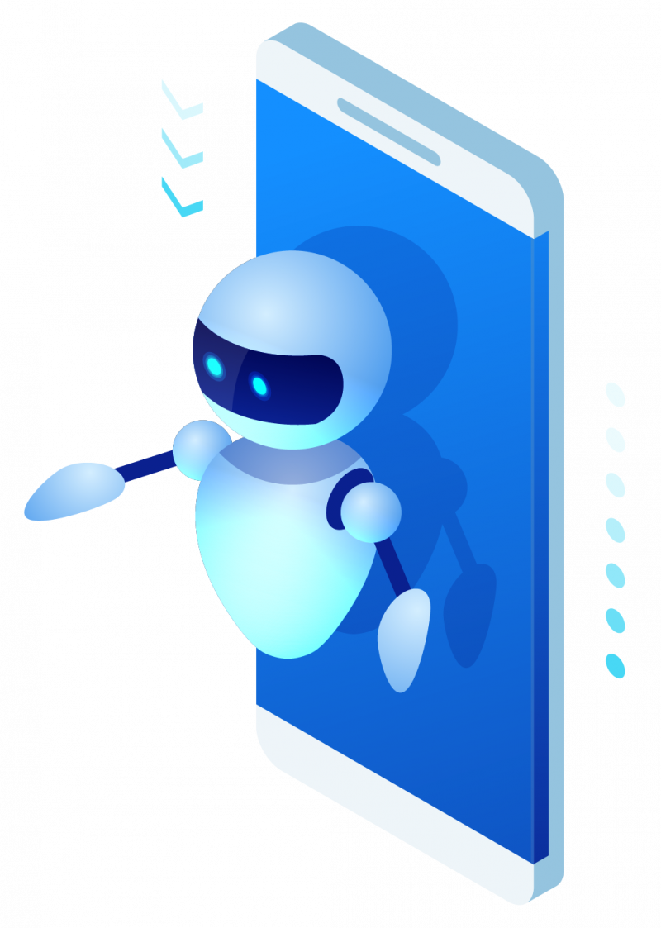
Lead Generation And Conversion
AI Chatbots drive lead generation by engaging prospects, capturing information, and nurturing leads, ultimately increasing conversion rates and sales.

Slide 11
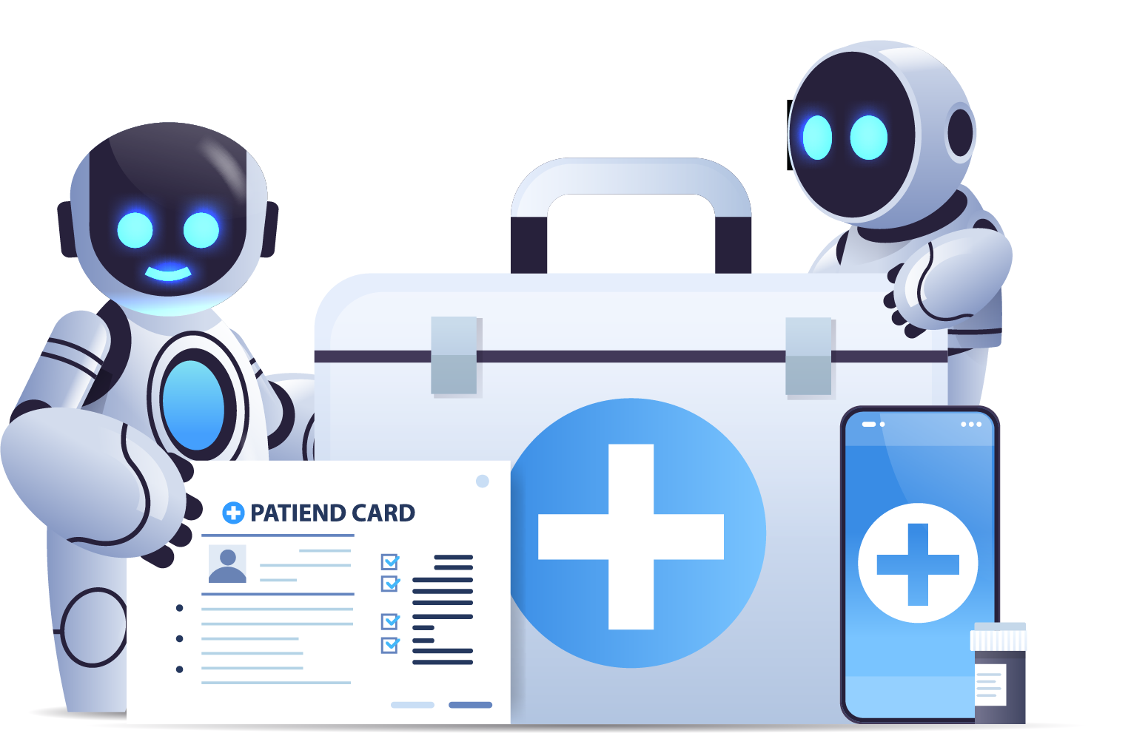
AI Chatbots In Healthcare
Symptom Assessment and Advice
AI Chatbots provide preliminary medical guidance based on symptoms.
Appointment Management
AI Chatbots assist in scheduling and reminding patients of healthcare appointments.
Health Monitoring and Education
AI Chatbots offer personalized health monitoring and educational resources.

Slide 12
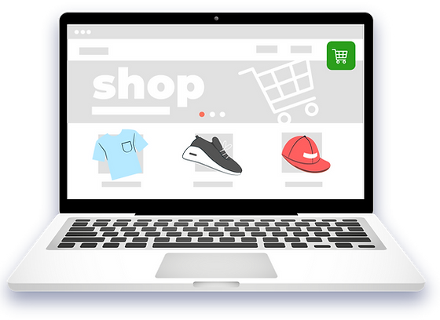
AI Chatbots In E-commerce
AI Chatbots in e-commerce offer personalized product recommendations, assist in purchase decisions, and provide seamless customer support and assistance.

Slide 13
Natural Language Understanding
Lack of Contextual Understanding
Emotional Intelligence
Handling Complex Queries
Lack of Creativity and Empathy
Challenges and limitations
Data Privacy and Security
User Trust and Transparency
Maintenance and Updates

Slide 14
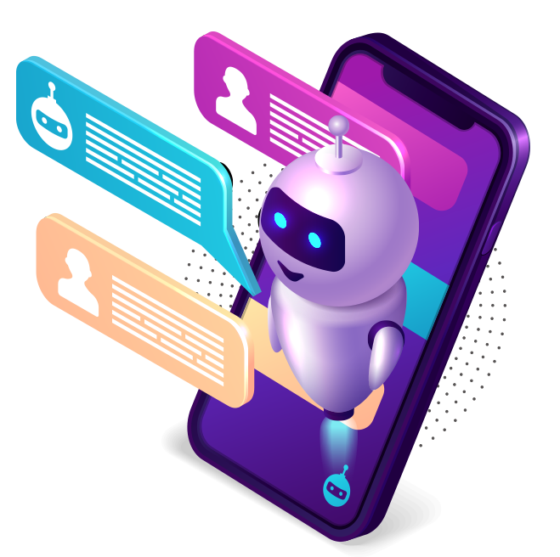
AI Chatbots In Virtual Assistants
AI Chatbots integrated into virtual assistants enhance their capabilities, enabling natural language interactions and seamless task automation.

Slide 15
AI Chatbots
For Knowledge Sharing
Instant Access
AI Chatbots provide immediate access to information, resources, and answers, enhancing knowledge sharing efficiency.
Personalized Assistance
AI Chatbots deliver tailored knowledge support, guiding users through information, learning materials, and relevant resources.

Slide 16
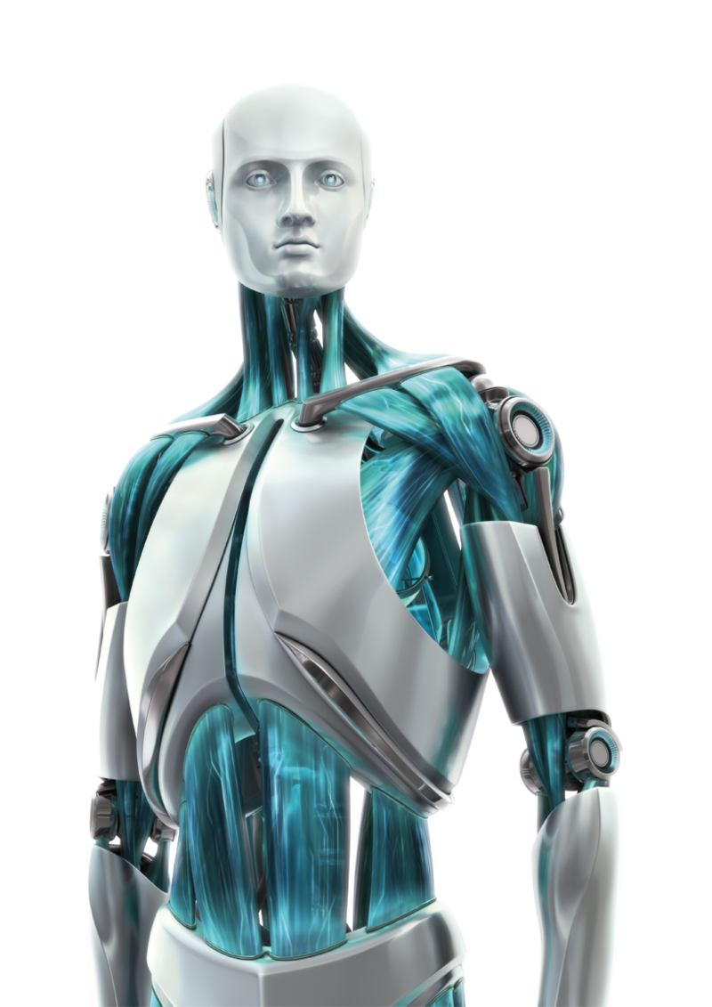
Human-AI Collaboration
Human-AI collaboration combines human expertise with AI Chatbots, enabling more efficient problem-solving, decision-making, and customer interactions.

Slide 17

AI Chatbots In Education
AI Chatbots in education facilitate personalized learning experiences, provide instant feedback, and support student engagement and progress tracking.

Slide 18
AI Chatbots For Social Media
AI chatbots have become increasingly popular for social media platforms as they offer businesses and users a range of benefits. Here are some ways AI chatbots are used on social media:
Customer Support
Interactive Content Delivery
Personalized Recommendations
Automated Posting and Scheduling
Lead Generation and Qualification
Influencer Marketing
Social Listening and Sentiment Analysis
Social Media Advertising

Slide 19
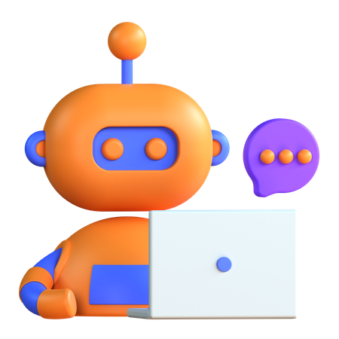
Future Trends In Technology
Future trends in technology include advancements in AI Chatbot capabilities, such as improved natural language understanding and contextual conversations.

Slide 20
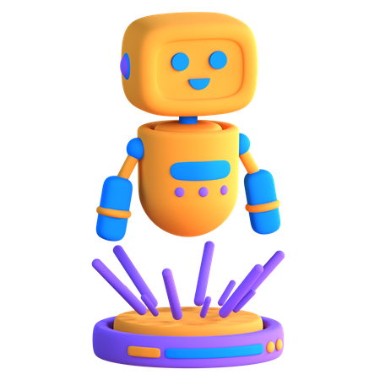
Conclusion
In conclusion, AI Chatbots revolutionize customer service, enhance user experiences, and drive operational efficiency, empowering businesses to thrive.

Slide 21
"AI is like a canvas, and human creativity is the paintbrush that brings it to life."

Slide 22
Icons

Slide 23
Icons

Slide 24
How To Edit Shapes
You can add and edit some shapes to your presentation to present your data in a visual way.
Choose your favourite infographic and insert it in your presentation using Ctrl C + Ctrl V or Cmd C + Cmd V in Mac.
Select one of the parts and ungroup it by right-clicking and choosing “Ungroup”.
Change the color by clicking on the paint bucket.
Then resize the element by clicking and dragging one of the square-shaped points of its bounding box (the cursor should look like a double-headed arrow). Remember to hold Shift while dragging to keep the proportions.
Group the elements again by selecting them, right-clicking and choosing “Group”.
Repeat the steps above with the other parts and when you’re done editing, copy the end result and paste it into your presentation.
Remember to choose the “Keep source formatting” option so that it keeps the design. For more info, please visit Slideegg (Tips & Tricks).

Slide 25
Terms Of Use (Free Users)
If you are a free subscriber, you should credit SlideEgg by keeping the “Thank You” slide.
Kindly refer to the following slide for the Terms of Use for premium users.
You can:
Customize or edit this template
Use this template for both business and personal endeavors.
You can not:
Sell, rent, or second-license SlideEgg content or its altered version. Promulgate, unless explicitly permitted, SlideEgg content, by SlideEgg.
Incorporate SlideEgg content in any database or file online or offline.
Obtain SlideEgg content’s copyright.
Kindly refer to our Tutorial page or FAQ for advanced slide modification guidelines.

Slide 26
Terms Of Use (Premium Users)
Being a premium subscriber, you have the privilege of using this PPT template
without giving attribution to SlideEgg or keeping the “Thank You” slide.
You can:
Customize or edit this template.
Use this template for both business and personal endeavors.
Circulate or share the editable format of this template with anyone you want.
You can not:
Sell, rent or second-license SlideEgg content or the altered version of it. Promulgate or include the templates in any other services database
that performs as distribution or resale platform, unless explicitly permitted, by SlideEgg.
Incorporate the elements used in SlideEgg templates separately.
Obtain SlideEgg copyright for the elements used in this template as a logo or trademark.
Kindly refer to our Tutorial page or FAQ for advanced slide modification guidelines.

Slide 27





Thank You!
We respect your valuable time with SlideEgg!
If you have any questions, please reach us
Do you have a design request, please visit our redesign page.
CREDIT: SlideEgg created this PowerPoint template.
Let this slide be kept for attribution.
www.slideegg.com

